Slide 1
.NET
Sunita Jain

Slide 2
Contents:
Features of C#
C# Compilation and Execution
Assemblies – EXE and DLL
Creating and Using a DLL
Classes, Objects and Methods
Data Types in C#
Value Types and Reference Types
Single Dimensional, Multi-Dimensional & Jagged arrays
Implicitly Typed Local variables
Var Keyword

Slide 3
What is .NET?
.NET is a free, open-source development platform for building many kinds of apps such as
Web apps, web APIs, and microservices
Cloud native apps
Mobile apps
Desktop apps
Windows WPF
Windows Form
Games
Internet of Things (IoT)
Machine learning
Windows services

Slide 4
Why .NET
Common Executive Environment
Multilanguage support
Common Type System
tool Support
Security
Automatic Resource Management
Portability

Slide 5
Introduction to .NET Framework
.NET framework is a software platform to built different types of applications such as windows ,web and mobile application.
.NET framework is a part of .NET
NET framework mainly consist 2 major components
CLR
FCL

Slide 6
Component of .NET Framework
C++
C#
VB
Perl
J#
…
Visual Studio .NET
C++
C#
VB
Common Language Specification
ASP .NET
Web Services Web Forms
Mobile Internet Toolkit
Windows
Forms
ADO .NET and XML
.NET Framework (Base Class Library)
Common Language Runtime
Operating System

Slide 7
CLR-Common language Runtime
CLR is runtime environment to execute .NET Apps. Commercial implementation of CLI by Microsoft.
CLR provides several runtime services such as
Class Loader
Memory Manager
Garbage Collection
JIT Complier
Exception Manager
Thread Manager
Security Manager
CLI – Common Language Infrastructure is an international standard that is the basis for creating execution and development environments in which languages and libraries work together seamlessly.

Slide 8
CLS-Common Language Specification
CLS is a set of specifications that must be met by every language to be considered as .NET compliant.
Example: Elimination of pointers and multiple inheritance.
CTS defines some basic data types and every language that is designed for use with .NET framework should be able to match its data types to these defined basic data types. So when various languages are designed following CTS, they will be able to communicate with each other and this is nothing but cross-language interoperability.

Slide 9
FCL-Framework Class Library
The .NET Framework class library is a collection of reusable types that tightly integrate with the common language runtime.
The class library is object oriented, providing types from which your own managed code derives functionality
Consists of classes, interfaces, and structures, delegates etc.
Reusable code that developers can use in own applications
are categorized using namespaces.

Slide 10
Introduction to C# Programming
C# (pronounced "See Sharp") is general-purpose programming language by Microsoft introduced in 2002, mainly used for console apps,Windows GUI apps and Windows Services.
approved by European Computer Manufacturers Association (ECMA) and International Standards Organization (ISO).
Developed by Microsoft within its .NET initiative led by Anders Hejlsberg
C# has its roots in the C family of languages and will be immediately familiar to C, C++, Java, and JavaScript programmers.
C# supports the concepts of encapsulation, inheritance, and polymorphism.
C# programming language can be used to develop different types of secured and robust applications.

Slide 11
C# Features
Simple and Modern
Object Oriented programming Language
Case sensitive Language
Strongly-Typed Language
Compiler-based Language
Interoperability
Automatic Memory Management and Garbage Collection.
Rich library
Exception Handling

Slide 12
C# Program Compilation and Execution
C# Source File(s)
Resources
C# Programs can be compiled and executed using
Command Prompt
Save the file as .cs extension:
Hello.cs
Compile the file using csc compiler:
csc Hello.cs
Execute the file:
Hello.exe or Hello
Visual Studio IDE
References
C# Compiler
Creates
Managed Assembly (.exe or .dll)
MSIL Metadata
IL metadata & references loaded by CLR
Common Language Runtime
Security/GC/JIT Compiler
.NET FCL
Uses
Converted to native machine code
Operating System

Slide 13
Dynamic Link Library (DLL)
A Dynamic Link library (DLL) is a library that contains functions and codes that can be used by more than one program at a time.
Both EXE and DLL files are executable program modules, but DLL cannot runs on its own. DLL needs to be taken in EXE to run it.
DLL files cannot be executed directly.
Once a DLL is created, it can be used in many applications.
To use DLL
Add the reference/import the DLL file

Slide 14
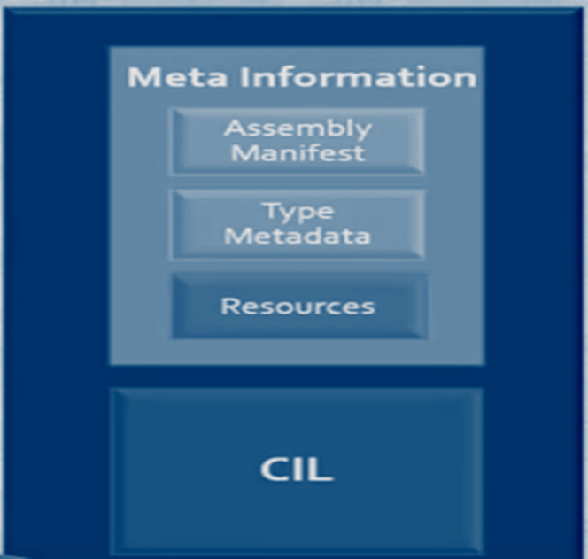
Assembly
An assembly is the smallest deployable unit of execution.
It is the basic building block of .NET Framework.
It Consists of Meta-Information and CIL/MSIL.
It is Self Descriptive
Have unique version number. Contains IL code to be executed.
There are two types of assemblies
Private: Can be used only in one application. Stored in the specific application’s directory or sub directory.
Public / Shared: Can be used by multiple client application. Stored in centralized shared folder called GAC (Global Assembly Cache).

Slide 15
Introducing OOP
Object Oriented programming
Programming model for scalable applications.
Used in the most popular languages such as java, python, java script,C++ etc.
Goal of OOP to group-up some data and its operations as a single unit called object.

Slide 16
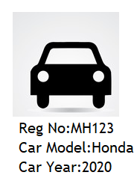


Object
Object is a small unit (entity)in a program that represents a real-world person or thing.

Slide 17
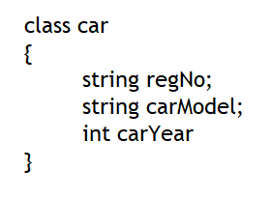
Class
Class is a model of object.
Class represents structure (list of fields and methods) of data that you want to store in similar object.

Slide 18
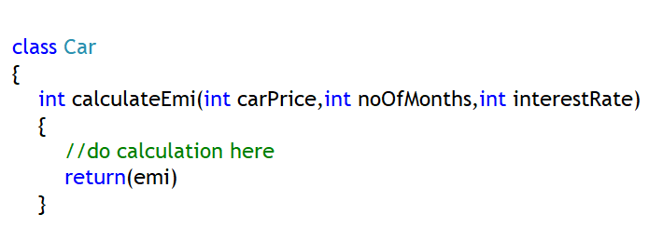
Methods
Method is a collection of statements to perform certain operation(Process or work) such as performing some calculations , displaying some output, checking some conditions etc.
Method should be a member (part)of class.

Slide 19
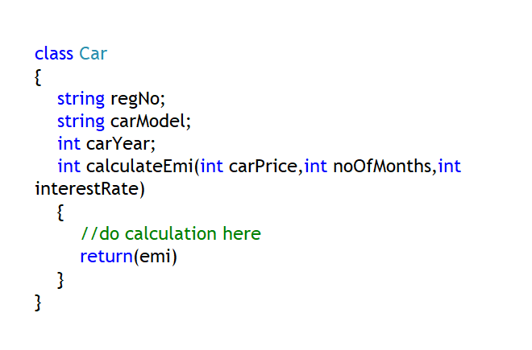
Object and Class Association
Object stores fields
Object associates with all methods of its class.
Means, object can call methods of its class.
Class declares the list of fields; defines list of methods.

Slide 20
Class
Syntax
class ClassName
{
Fields
methods
properties
constructor
Event
Destructor
}

Slide 21
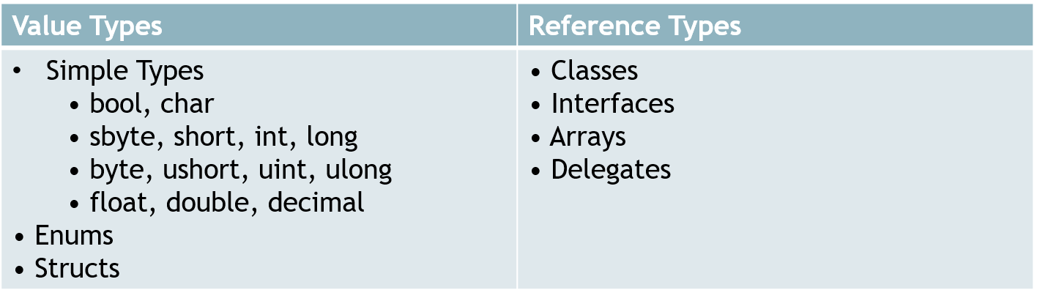
Data Types in C#

Slide 22
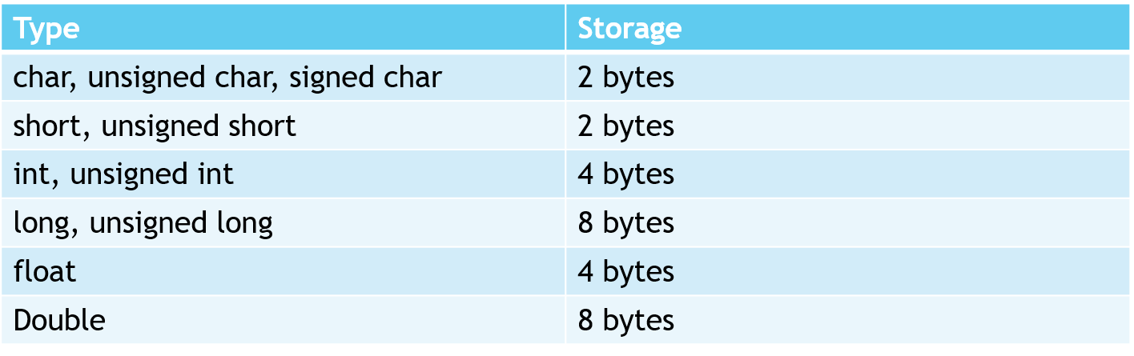
Storage of Basic Types

Slide 23
Data Types
C# Type | CLR Type
Bool | System.Boolean
Byte | System.Byte
SByte | System.SByte
Char | System.Char
Decimal | System.Decimal
Double | System.Double
Float | System.Single
Int | System.Int32
Uint | System.UInt32
Long | System.Int64
Ulong | System.UInt64
Object | System.Object
Short | System.Int16
Ushort | System.UInt16
String | System.String

Slide 24
Value Type
A variable of a value type always contains a value of that type.
The assignment to a variable of a value type creates a copy of the assigned value.
Categories of value types are as follows:
Struct type: user-defined struct types, Numeric types, Integral types, Floating-point types, decimal, bool
Enumeration type

Slide 25
Reference Type
Variables of reference types, also referred to as objects, store references to the actual data.
Assignment to a variable of a reference type creates a copy of the reference but not of the referenced object.
Following are some of the reference types:
Class
Interfaces
Delegates
The following are built-in reference types:
Object
string

Slide 26
Comparison between Data Types in C#
Value Types | Reference Types
The variable contains the value directly | The variable contains a reference to the data (data is stored in separate memory area)
Allocated on stack | Allocated on heap using the new keyword
Assigned as copies | Assigned as references
Default behavior is pass by value | Passed by reference
== and != compare values | == and != compare the references, not the values
simple types, structs, enums | classes

Slide 27
Operators
Operator is symbol to perform operations.
Ex: +,-,*,/,== etc.
Types of Operators:
Arithmetical Operators
Assignment Operators
Increment and Decrement Operators
Comparison Operators
Logical Operators
Concatenation operators
Ternary Operators

Slide 28
Arithmetical Operators
Used to perform arithmetical operations on Numbers.
List of operators
+ | Addition
- | Subtraction
* | Multiplication
/ | Division
% | Remainder

Slide 29
Assignment Operators
Used to perform arithmetical calculations on numbers.
List of Operators:
= | Assign to
+= | Add & assign to
-= | Subtract & assign to
*= | Multiply & assign to
/= | Divide & assign to
%= | Remainder & assign to

Slide 30
Increment and Decrement Operators
n++ | Post Increment
++n | Pre-Increment
n-- | Post-Decrement
--n | Pre-decrement

Slide 31
Comparison Operators
Used to compare 2 values and return true / false, based on condition.
List of Operators:
== | Equal to
!= | Not equal to
< | Less than
> | Greater than
<= | Less than equal to
>= | Greater than equal to

Slide 32
Logical Operators
Check both operands(Boolean) and returns true/false
List of Operators:
&& | AND
|| | OR
^ | XOR(Exclusive OR)
! | Negation (True becomes false & false becomes true)

Slide 33
Concatenation Operator
Attaches second operand string at the end of first operand string and returns the combined string.
+ “Hello”+ “World” returns “HelloWorld” (as string).
String + String | Returns String
String + Number | Returns String
Number+ String | Returns String

Slide 34
Ternary Operator
It evaluates the given Boolean value;
Returns first expression (consequent) if true;
Returns second expression(alternative) if false.
?: (condition)? (consequent): (alternative)

Slide 35
Operator Precedence
Operators are evaluated based on the order of precedence.
Highest precedence appear at the top of the table.
Category | Operator
Postfix | () [] ++ --
Unary | + - !
Multiplicative | * / %
Additive | + -
Relational | < <= > >=
Equality | == !=
Logical AND | &&
Logical OR | ||
Conditional | ?:
Assignment | = += -= *= /= %=

Slide 36
Control Statements
Control statements are used to control the program execution flow.
Used to make execution flow “jump forward” or “jump backward”.

Slide 37
Control Statements
Classification of Control Statements:
Conditional Control Statements:
If
Switch-case
Looping Control Statements:
While
Do-while
For
Jumping Control Statements:
Break
Continue

Slide 38
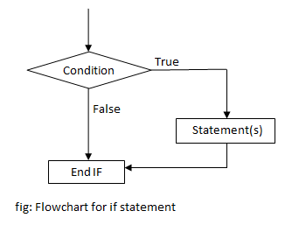
If Statement

Slide 39
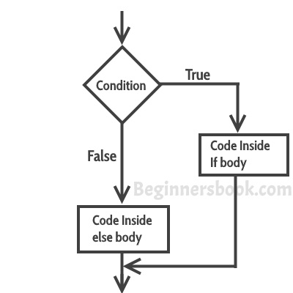
If–else Statement

Slide 40
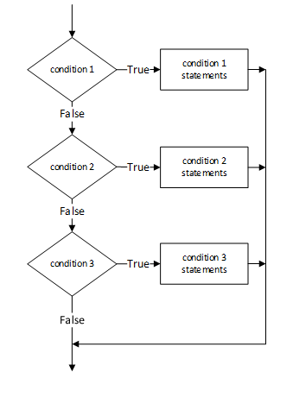
If-else if statement

Slide 41
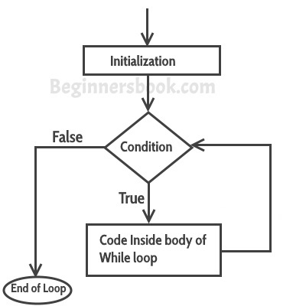
While Loop

Slide 42
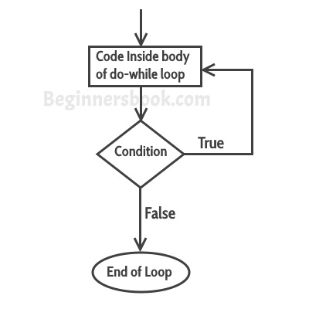
Do-While Loop

Slide 43
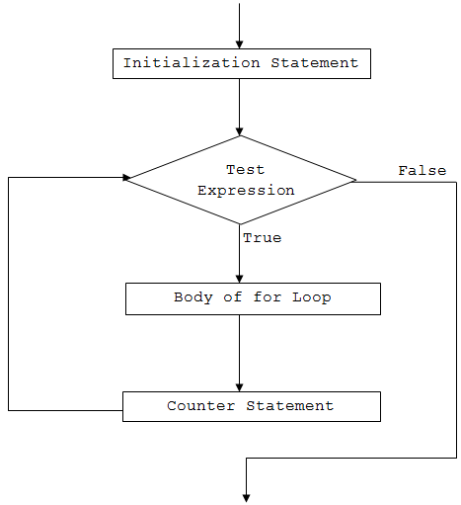
For Loop

Slide 44
Boxing and Unboxing
Boxing and unboxing enable value types to be treated as objects.
Value types, including both struct types and built-in types, such as int, can be converted to and from the type object.
Boxing is implicit conversion
Boxing Example:
int number = 2000;
object obj = number;
Now both the integer variable and the object variable exist on the stack, but the value of the object resides on the heap.
Unboxing Conversions
int anothernumber = (int)obj;

Slide 45
Arrays
An array is a data structure that contains a number of variables called the elements of the array
C# arrays are zero indexed; that is, the array indexes start at zero.
All of the array elements must be of the same type, which is called the element type of the array.
Array elements can be of any type, including an array type.
An array can be a single-dimensional array, a multidimensional array or a Jagged Array (Array of Arrays).
Array types are reference type derived from the abstract base type System.Array.

Slide 46
Single and Multi Dimensional Array
Single Dimensional Array
int[] array1 = new int[5];
string[] stringArray = new string[6];
int[] array2 = new int[] { 1, 3, 5, 7, 9 };
int[] array3 = { 1, 2, 3, 4, 5, 6 };
Multi Dimensional Array
int[,] multiDimensionalArray1 = new int[2, 3];
int[,] multiDimensionalArray2 = { { 1, 2, 3 }, { 4, 5, 6 } };

Slide 47
Jagged Array
Jagged array is an array whose elements are arrays.
The elements of a jagged array can be of different dimensions and sizes.
A jagged array is sometimes called an "array of arrays."
The following is a declaration of a single-dimensional array that has three elements, each of which is a single-dimensional array of integers:
int[][] jaggedArray = new int[2][];
jaggedArray[0] = new int[5];
jaggedArray[1] = new int[4];
jaggedArray[2] = new int[2];
Each of the elements is a single-dimensional array of integers

Slide 48
Jagged Array
The first element is an array of 5 integers, the second is an array of 4 integers, and the third is an array of 2 integers.
It is also possible to use initializers to fill the array elements with values, in which case you do not need the array size. For example:
jaggedArray[0] = new int[] { 1, 3, 5, 7, 9 };
jaggedArray[1] = new int[] { 0, 2, 4, 6 };
jaggedArray[2] = new int[] { 11, 22 };

Slide 49
Implicitly Typed Local variables-var
Local variables can be declared without giving an explicit type.
The var keyword instructs the compiler to infer the type of the variable from the expression on the right side of the initialization statement.
The inferred type may be a built-in type, an anonymous type, a user-defined type, or a type defined in the .NET class library.
// i is compiled as an int
var i = 5;
// s is compiled as a string
var s = "Hello";
// a is compiled as int[]
var a = new[] { 0, 1, 2 };

Slide 50
Implicitly Typed Local variables-var
The following restrictions apply to implicitly-typed variable declarations:
var can only be used when a local variable is declared and initialized in the same statement; the variable cannot be initialized to null, or to a method group or an anonymous function.
var cannot be used on fields at class scope.
Variables declared by using var cannot be used in the initialization expression. In other words, this expression is legal: int i = (i = 20); but this expression produces a compile-time error: var i = (i = 20);

